Slide 1
Prokaryotic cell structure
Dr. Sahar Mahdi

Slide 2
-Flagellum (only in some types of prokaryotes).
- Long, whip-like protrusion that aids cellular locomotion
- Confer motility
- 20 nm in diameter
- Helical
A flagellum (plural: flagella) is an appendage composed of protein flagellin . The primary role of the flagellum is locomotion, but it also often has function as a sensory organelle, being sensitive to chemicals and temperature outside the cell.

Slide 3
Consists of
1-filament
◙ from cell surface to top
◙ hollow made of flagellin protein
2- Basal body
◙ Embedded in cell
◙ Anchors flagellum
3-Hook
◙ hooks filament to the basal body
Basal body is made up of a series of rings
► gram negative bacteria have four rings connected to a central rod (L,M and S)
►gram positive bacteria have two rings
* One attaches to PM
* Other attaches to peptidoglycan PTG

Slide 4
Gram negative bacteria

Slide 6
Flagellar arrangement schemes
Examples of bacterial flagella arrangement schemes.
A-monotrichous B-lophotrichous C-amphitrichous D-peritrichous
Different species of bacteria have different numbers
and arrangements of flagella.

Slide 7
Monotrichous bacteria have a single flagellum (e.g., Vibrio cholerae).
Lophotrichous bacteria have multiple flagella located at the same spot on the bacterial surfaces which act in concert to drive the bacteria in a single direction. In many cases, the bases of multiple flagella are surrounded by a specialized region of the cell membrane, the so-called polar organelle.
Amphitrichous bacteria have a single flagellum on each of two opposite ends (only one flagellum operates at a time, allowing the bacterium to reverse course rapidly by switching which flagellum is active).
Peritrichous bacteria have flagella projecting in all directions (e.g., E. coli).

Slide 9
Function of bacterial flagella
-Rotation propels bacterium through environment
-Rotation can be clockwise or counterclockwise reversible
- Bacteria move in response to stimuli (taxis)
◙ Runs – movements of cell in single direction for some time due to counterclockwise flagellar rotation; increase with favorable stimuli (positive chemotaxis, positive phototaxis)
◙ tumbles – abrupt , random changes in direction due to clockwise flagellar rotation; increase with unfavorable stimuli (negative chemotaxis, negative phototaxis).

Slide 10
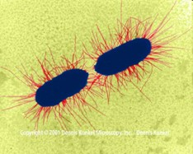
Fimbriae (Aka pili)
◙ Very thin appendages (3-10nm in diameter)
◙ Involved in attachment, not motility
◙ Made of pillin (phosphate- carbohydrate protein complex)
◙ Often called adhesion

Slide 11
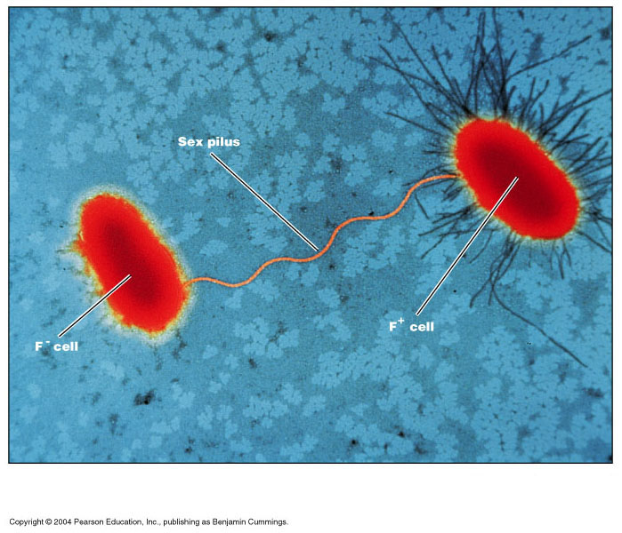
◙ Sex pilus
◙ Usually longer 9-10 nm in diameter
◙ Similar to fimbiae
◙ DNA transfer (conjugation)
◙ often have receptors for bacteriophages (filamentous phage)

Slide 12
Cytoplasmic Membrane
The cytoplasmic membrane is a thin phospholipids bilayer (6 to 8 nanometers) that completely surrounds the cell and separates the inside from the outside.
Its selectively-permeable nature keeps ions, proteins, and other molecules within the cell,
preventing them from diffusing into the extracellular environment, while other molecules may move through the membrane.

Slide 13
Cytoplasm of a prokaryotes:
- The cytoplasm of a prokaryotic cell is everything that is present inside the bacterium..
- The cytoplasm houses all the chemicals and components that are used to sustain the life of a bacterium,
The cytoplasm is bounded by the cytoplasmic membrane. Gram-negative bacteria contain another outer membrane. In between the two membranes lies the periplasm.
- The genome is apparent as a more diffuse area within the granular cytoplasm. This artificial structure has been called the nucleoid. Smaller, circular arrangements of genetic material called plasmids can also be present.

Slide 14
Also present throughout the cytoplasm is the ribonucleic acid , various enzymes , amino acids, carbohydrates, lipids, ions, and other compounds that function in the bacterium. The constituents of the membrane(s) are manufactured in the cytoplasm and then are transported to their final destination.
- Some bacteria contain specialized regions known as cytoplasmic inclusions that perform specialized functions. These inclusions can be stored products that are used for the nutrition of the bacteria.
- Examples of such inclusions are glycogen, poly-B-hydroxybutyrate, and sulfur granules.

Slide 15
- As well, certain bacteria contain gas-filled vesicles that act to buoy the bacterium up to a certain depth in the water, or membranous structures that contain chlorophyll . The latter function to harvest light for energy in photosynthetic bacteria.
-The cytoplasm of prokaryotic cells also houses the ribosomes required for the manufacture of protein. The processes of transcription , translation , protein import and export

Slide 16
Intracellular membrane
Mesosomes
-Mesosomes are part of the structure of the plasma membrane, lining the cell wall.
- They are clumped and folded together, to maximize their surface area. This is important because it is needed for cell respiration, which is a function of the Mesosomes.
- They play a role in cellular respiration, the process that breaks down food to release energy.
- Mesosomes are the principal sites of respiratory enzymes, can easily be demonstrated in gram positive bacteria, are essential in bringing about cell division.

Slide 17
Inclusion bodies
- Inclusion bodies are non-living substances present in the vacuoles, cytoplasm or cell wall.
- They are a kind of storage granules lying freely in the cytoplasm.
- The inclusion bodies are the bacterial cellular reserve materials.
They are of two types:
Organic inclusion bodies: They include cyanophycean starch granules and glycogen granules.
Inorganic inclusion bodies: They include polyphosphate granules and sulphur granules.

Slide 19
Ribosome
◙ The ribosome is a simple molecular machine, found within all living cells, that serves as the site of biological protein synthesis (translation).
◙ Ribosomes link amino acids together in the order specified by messenger RNA (mRNA) molecules.
◙ Ribosomes consist of two major components: the small ribosomal subunit, which reads the RNA, and the large subunit, which joins amino acids to form a polypeptide chain.
◙ Each subunit is composed of one or more ribosomal RNA (rRNA) molecules and a variety of ribosomal proteins. The ribosomes and associated molecules are also known as the translational apparatus.

Slide 20
s=sedimentation coefficient…. affected by molecular weight , volume and shape
s=sedimentation coefficient…. affected by molecular weight , volume and shape

Slide 21
Nucleiod Region
- Area of the cytoplasm that contains the single bacterial DNA molecule.
Prokaryotic cells lack a nucleus
They do have DNA, the DNA exists freely in the cytoplasm as a closed loop. It has no protein to support it and no membrane covering it. A bacterium typically has a single looped chromosome.
Plasmids :
Plasmids are gene carrying, circular DNA structures that are not involved in reproduction

Slide 23
Nucleiod:
►nuclear body chromatin body, the DNA of bacteria is usually a single circular molecule located in the nucleiod
► nucleoids are present prior to cell division
►sometimes found to be associated with the plasma membrane or with mesosomes

Slide 24
Spores
►A bacterial spore is a structure produced by bacteria that is resistant to many environmental or induced factors that the bacteria may be subjected to.
► These spores help the bacteria to survive by being resistant to extreme changes in the bacteria's habitat including extreme temperatures, lack of moisture or being exposed to chemicals and radiation.
► Bacterial spores can also survive at low nutrient levels and antibiotics
►Most bacterial spores are not toxic and do not cause any harm, but some bacteria that produce spores can be pathogenic.
►Most spore-forming bacteria are contained in the bacillus and clostridium species but can be found in other species of bacteria as well.

Slide 25
►There are different types of spores including endospores, exospores, and spore-like structures called microbial cysts.
►Bacterial spores are extremely resistant. Spores of tetanus and anthrax, for example, can survive in the soil for many years.
►Under the microscope, a small, round, bright body inside bacterial cells. This survived even when the bacteria were boiled for five minutes. This killed the bacteria, but not the spores.
►They germinated when conditions were right. Because spores are so resistant, they are highly transmissible(معدي). This makes them a very problematic aspect of spore-forming pathogens such as Clostridium

Slide 29
Sterilization and Disinfection
▀ Aseptic techniques to prevent contamination of surgical wounds. Prior to this development: Nosocomial infections (المكتسبة في المستشفيات) caused death in 10% of surgeries (بعض من هذه العدوى التي تحدث في المرضى بعد الدخول إلى المستشفى يسمى عدوى المستشفيات)
▀ Up to 25 % mothers delivering in hospitals died due to infection.
Sterilization
The process of freeing an article from microorganisms including their spores.
Disinfection:
Reducing the number of pathogenic microorganisms to the point where they no longer cause diseases.
Bacteriostatic Agent:
An agent that inhibits the growth of bacteria but dose not necessarily kill them.
Sepsis: Comes from Greek for decay or putrid. Indicates bacterial contamination.

Slide 30
▀ Asepsis: Absence of significant contamination.
▀ Aseptic techniques are used to prevent contamination of surgical instruments, medical personnel and the patient during surgery.
Bactericide or Bactericidal:
▀ An agent that kill bacteria , most do not kill endospores.
Sporicide:
▀ An agent that kills spores.

Slide 34
Uses
◙ to sterilize forceps, Scissors, Scalpels, Swabs.
◙ Pharmaceuticals products like liquid paraffin, dusting power, fats and grease.
Incineration
This is an excellent method of destroying materials such as contamination cloth, animal carcasses and pathological materials.

Slide 35
physical methods of sterilization
Sterilization by dry heat
۞ kills by oxidation effects
۞ the oven utilizes dry heat to sterilize articles
۞ operated between 50° C to 250-300 ° C
۞ a holding period of 160 °C for 1 hr. is desirable.
۞ there is a thermostat controlling the temperature
۞ double walled insulation keeps the heat in and conserves energy

Slide 37
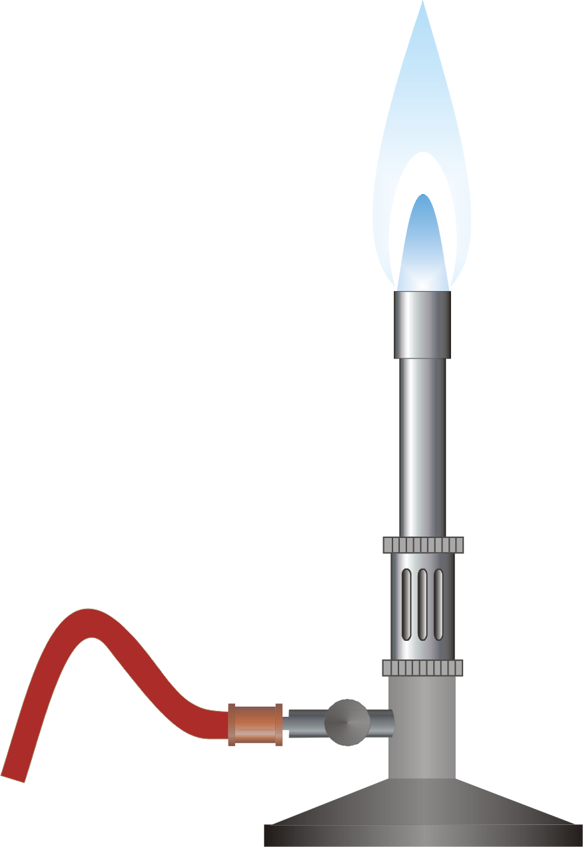
1- Hot air oven
2- Flaming
۞ Inoculation loop or wire the tip of forceps and spatulas are held in a Bunsen flame till they are red hot .

Slide 39
B- Moist heat sterilization
◙ kills microorganisms by coagulating their proteins.
1- Pasteurization
◙ Process of killing of pathogens in the milk but dose not sterilize it .
◙ Milk is heated at 63 °C for 30 mins. (holder method)
◙ At 72 °C for 15-20 sec. rapid cooling to 13 °C (flash process).

Slide 40
Moist heat sterilization is carried out with following methods
1- Temperature below 100°C " pasteurization" .
2- Temperature at 100°C boiling.
3- Steam at atmospheric pressure " Koch\ Arnold's steamer
4- Steam under pressure "Autoclave“
Hot water bath
- To inactivate non sporing bacteria for the preparation of vaccines – Special vaccine bath at 60°C for one hour is used.
- Serum or body fluid containing
- Coagulable proteins can be sterilized by heating for 1 hr. at 56°C in water bath for several successive days.

Slide 41
Temperature at 100°C
Boiling:
- kills vegetative forms of bacterial pathogens.
► Hepatitis virus; can survive up to 30 minutes of boiling
► Endospores ; can survive up to 20 hours or more of boiling.
Steam at atmospheric pressure
- Steam is generated using a steamer (Koch\ Arnold)
- consists of a tin cabinet
- has a conical lid to enable the drainage of condensed steam
- perforated tray above ensures materials are surrounded by steam.
- for routine sterilization exposure of 90 min is used.
- for media containing sugar and gelatin exposure of 100°C for 20 min for 3 successive days is used.
█ the process is termed as
- Tyndallisation\ intermittent sterilization((التندلة او التعقيم المتقطع

Slide 42
Steam under pressure - Autoclave
- is a pressure chamber used to carry out industrial processes requiring elevated temperature and pressure
- Autoclave consists of a vertical or a horizontal cylinder.
- Autoclaves are used in medical applications to perform sterilization and in the chemical industry to cure coatings and vulcanize rubber and for hydrothermal synthesis
-Many autoclaves are used to sterilize equipment and supplies by subjecting them to high-pressure saturated steam at 121 °C for around 15–20 minutes depending on the contents
- The autoclave was invented by Charles Chamberlandin 1879
- Typical loads include laboratory glassware, other equipment and waste, surgical instruments, and medical waste.

Slide 43
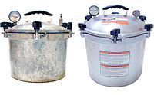
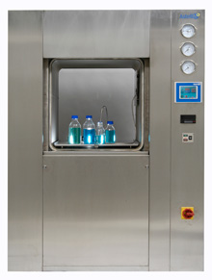

Slide 44
Alcohols
- Ethanol, isopropyl alcohol are frequently used.
- No action on spores
- Concentration recommended 60-90% in water
Uses:
- Disinfection of clinical thermometer.
- Disinfection of skin- venupuncture.
chemical agents
chemical agent act by:
- protein coagulation
-disruption of the cell membrane
-removal of sulphydryl groups
- substrate competition

Slide 45
Aldehydes
- formaldehyde is bactericidal , sporicidal and has a lethal effect on viruses
formaldehyde uses:
- to preserve anatomical specimens
-destroying Anthrax spores in hair and wool
- 10% formalin + 0.5% Sodium tetra borate ia used to sterilize metal instruments
Dyes
two groups of dyes are used:
1- Aniline dyes
- are brilliant green , malachite green and crystal violet
- Active against Gram positive bacteria
- no activity against tubercle bacilli.
2- Acridine dyes
- Acridine dyes are orange in colour
- Effective against Gram positive than Gram negative
- important dyes are proflavine, Acriflavine and Euflavine.

Slide 46
Halogens
- Iodine in aqueous and alcohol solution has been used widely as a skin disinfectant
- Actively bactericidal with moderate against spores
- Chlorine and its compounds have been used as disinfectants in water supplies and swimming pools.
Uses
- Specially used for sterilizing heart-lung machines , respirators , sutures , dental equipments, books and clothing
- used to sterilize Glass , metal and paper surfaces, plastics some food and tobacco

Slide 47
Gases
Ethylene oxide
-Colorless, highly penetrating gas with a sweet ethereal smell.
- Effective against all type of microorganisms including viruses and spores.
Formaldehyde gas
- Widely employed for fumigation of operation theaters and other rooms
Sterilization by filtration
Filtration helps to remove bacteria from heat labile liquids such as sera and solutions of sugars and antibiotics.
The following filters are used :
1- Candle filters
2- Asbestos filters
3- Sintered glass filters
4- Membrane filters
Candle filters
- widely used for purification of water . There are two types:
a- Unglazed ceramic filter- chamberland filter
b- Diatomaceous earth filters- Berkefeld filters

Slide 48
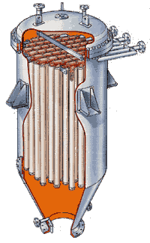

Slide 49
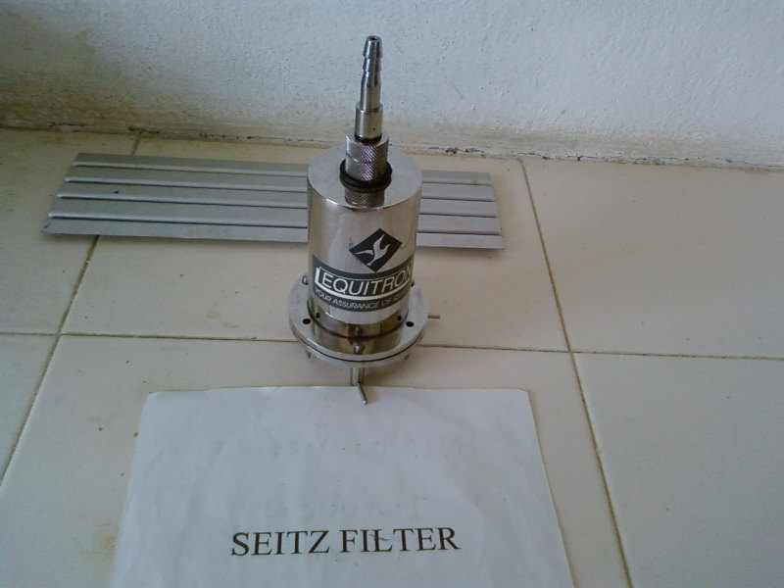
Asbestos filter
- disposable single use discs
- high adsorbing tendency
-carcinogenic
ex. Seitz filter

Slide 50
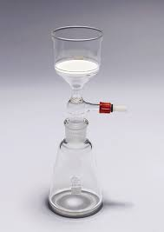
Sintered glass filter
- prepared by heat fusing powered glass particles of graded size

Slide 51
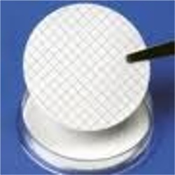
Membrane filters
- made of cellulose esters or other polymers
uses:
- water purification and analysis
- sterilization sterility testing .
- preparation of solution for parenteral use

Slide 52
Non- ionizing radiation
- electromagnetic rays with longer wavelength.
- Absorbed as heat.
- Can be considered as hot air sterilization .
- Used in rapid mass sterilization of prepacked syringes and catheters
ex: UV rays
Radiation
Two types of radiations are used
1-Non- ionizing
2- Ionizing
Ionizing radiations
- X- rays, gamma rays and cosmic rays
- High penetrative power
- No appreciable increase in the temperature- cold sterilization
- Sterilize plastics Syringes , catheters, grease fabrics metal foils.
Transonic and sonic vibration
- bactericidal
- microorganisms vary in their sensitivity hence no practical value in sterilization and disinfection

